Slide 1




Introduction to Web Design

Slide 2
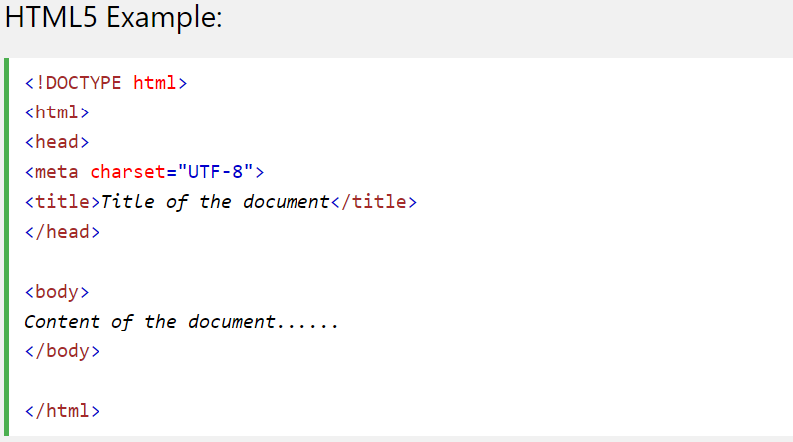
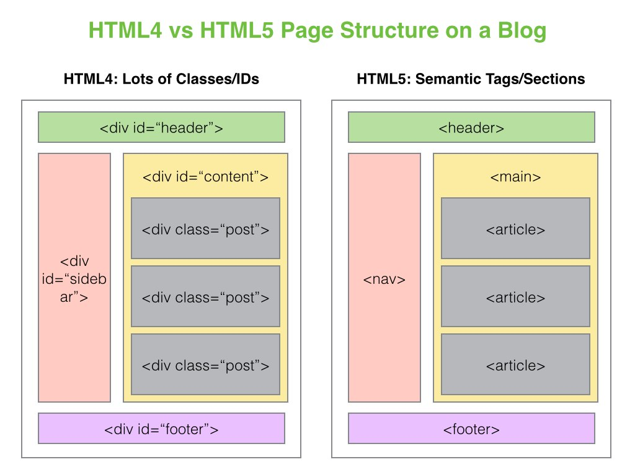
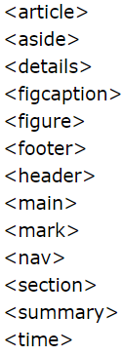
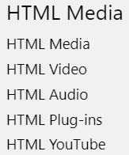
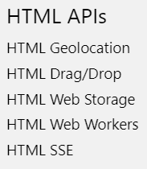
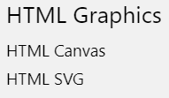
HTML5
https://www.w3schools.com/html/html5_semantic_elements.asp
https://www.w3schools.com/tags/default.asp

Slide 3
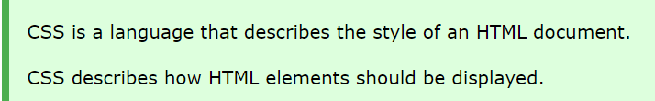


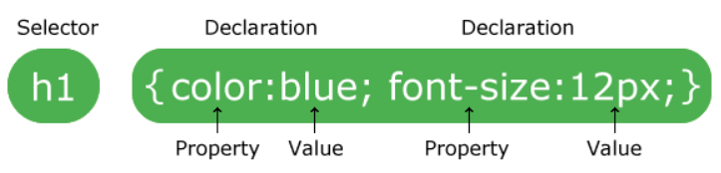
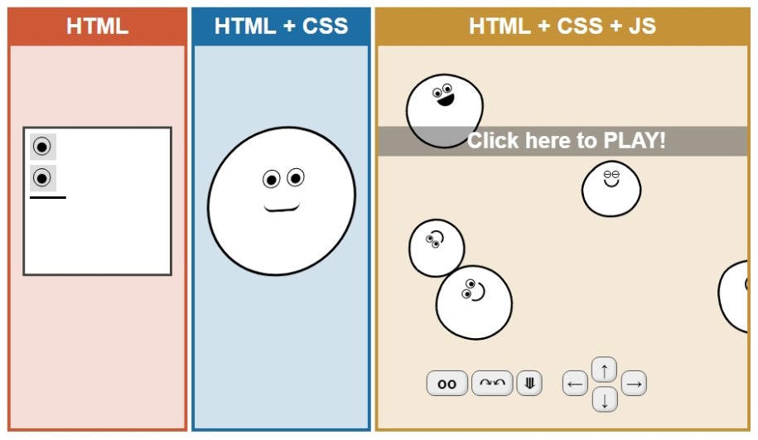
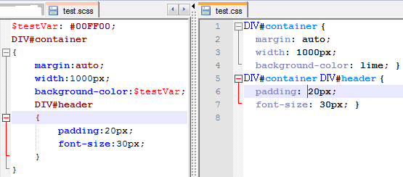
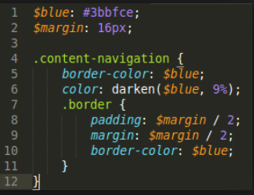
CSS3
https://www.w3schools.com/css/css_intro.asp

Slide 4
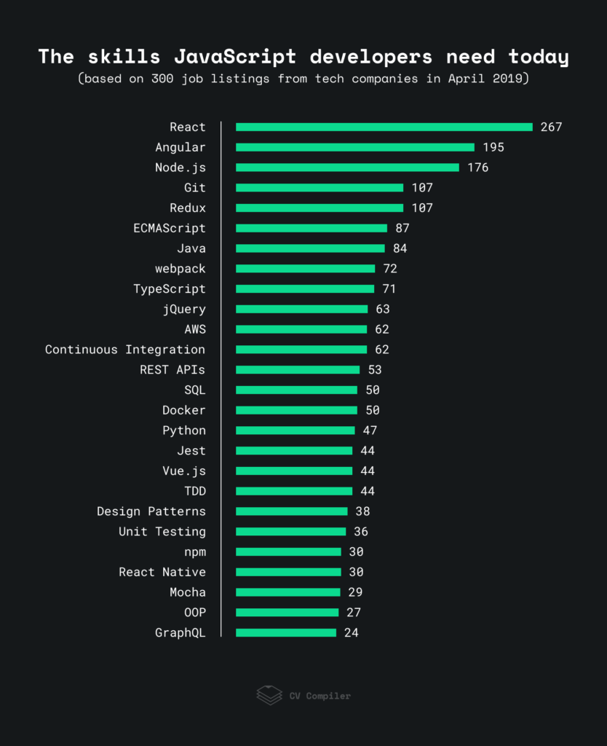
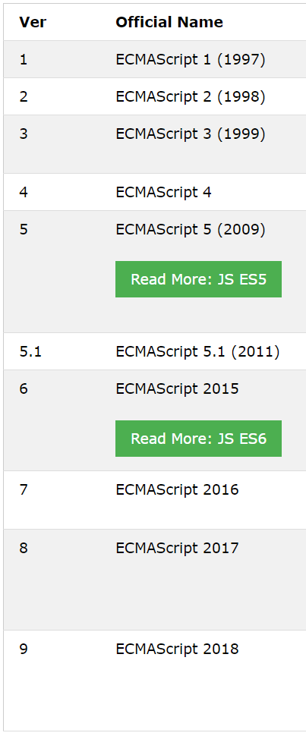
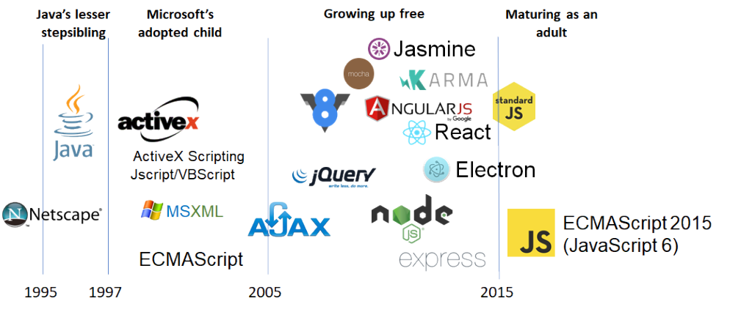
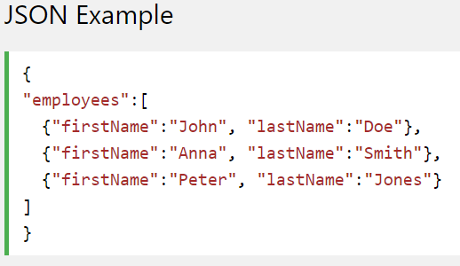

Javascript & jQuery

Slide 5
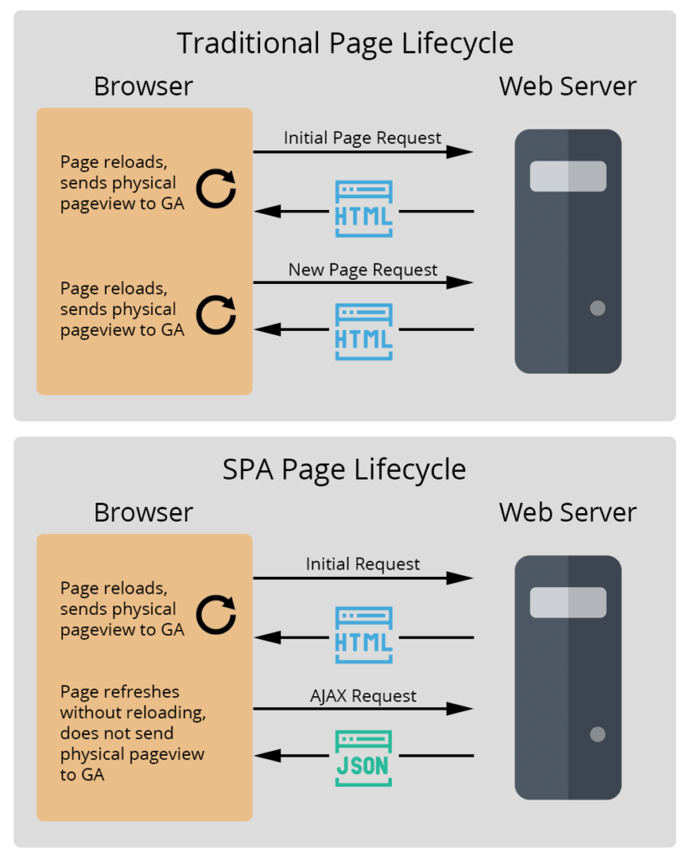
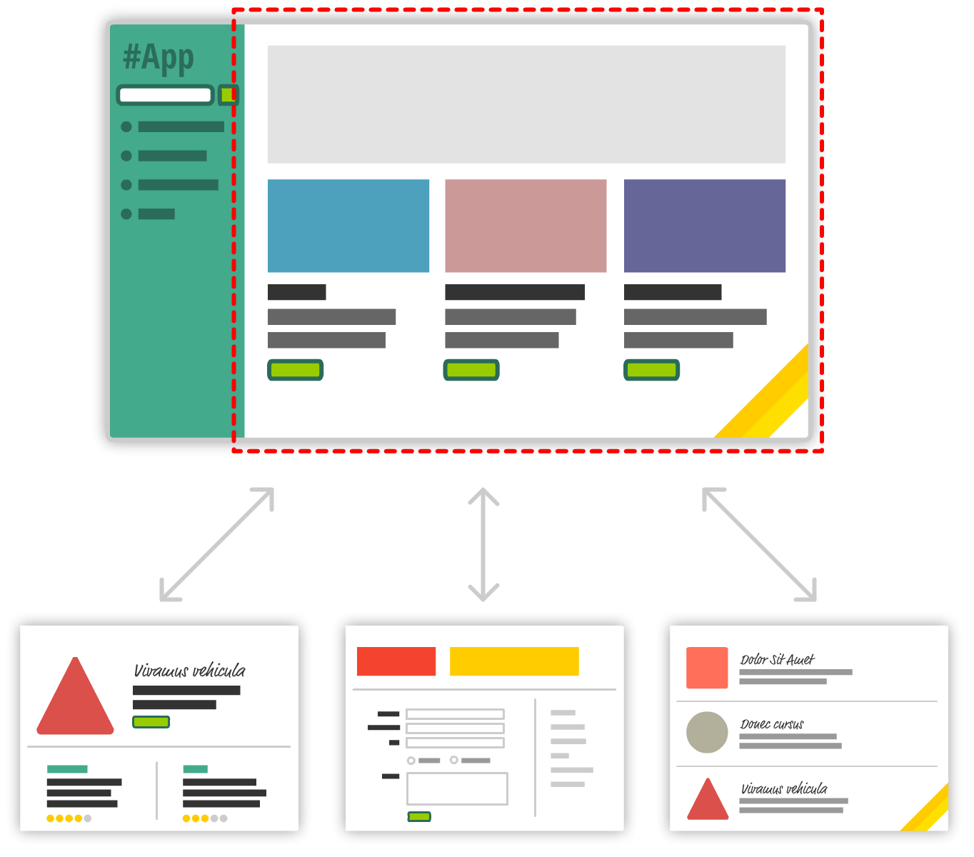
SPA
http://todomvc.com/

Slide 6

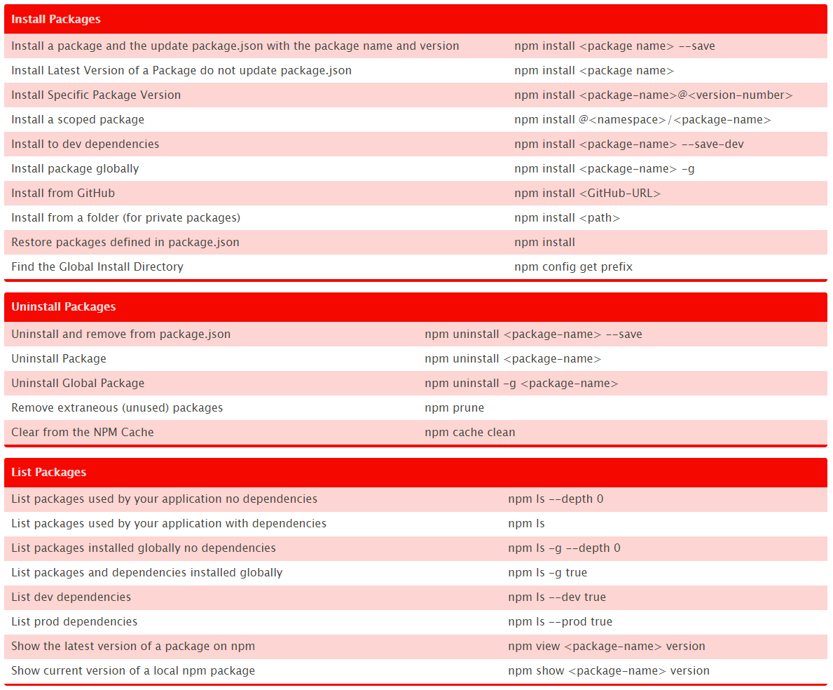
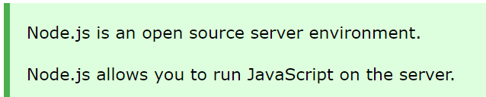
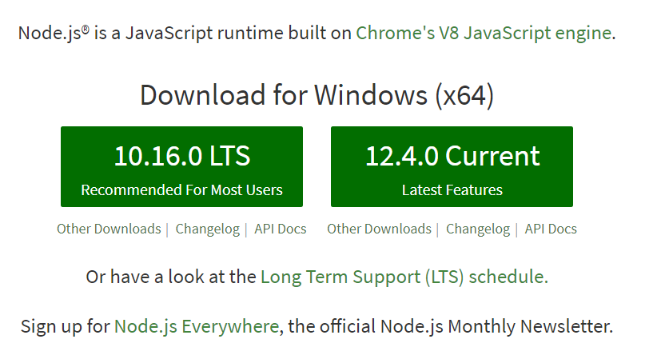
Node JS & NPM JS
https://nodejs.org/en/download/

Slide 7


TypeScript V3.4

Slide 8
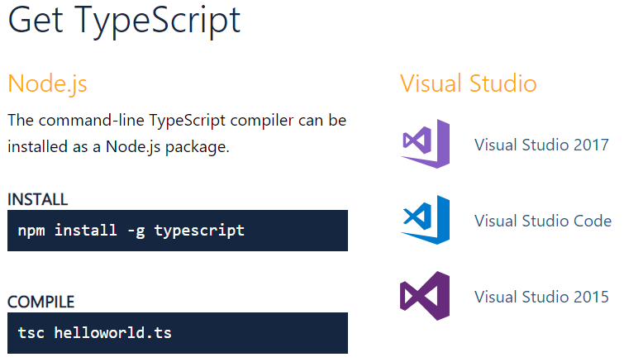
What is Typescript & How do you get it ?
Typescript is a TYPED superset of Javascript that compiles to plain Javascript
tsconfig.json

Slide 9
Basic Types
Boolean
Number
String
Array
Tuple
Enum
Any
Void
Null & Undefined
Never
Object
Var
Let
Const
Destructuring
Arrays
Tuples
…(Rest operator)
Interfaces
Properties
Optional Properties
Readonly Properties
Readonly Vs Const
FunctionTypes
Implementing Interfaces
Static Class
Instance Class Types
Extend Interface
https://www.sitepen.com/blog/2018/10/29/update-the-definitive-typescript-guide/

Slide 10
Interfaces, Classes & Functions
Interfaces
Properties
Optional Properties
Readonly Properties
Readonly Vs Const
FunctionTypes
Implementing Interfaces
Static Class
Instance Class Types
Extend Interface
https://www.sitepen.com/blog/2018/10/29/update-the-definitive-typescript-guide/

Slide 11


To start with Angular development Install the following
Node.Js
npm package manager
Angular CLI
npm install -g @angular/cli
ng --version
cd my-app
ng serve --open

Slide 12
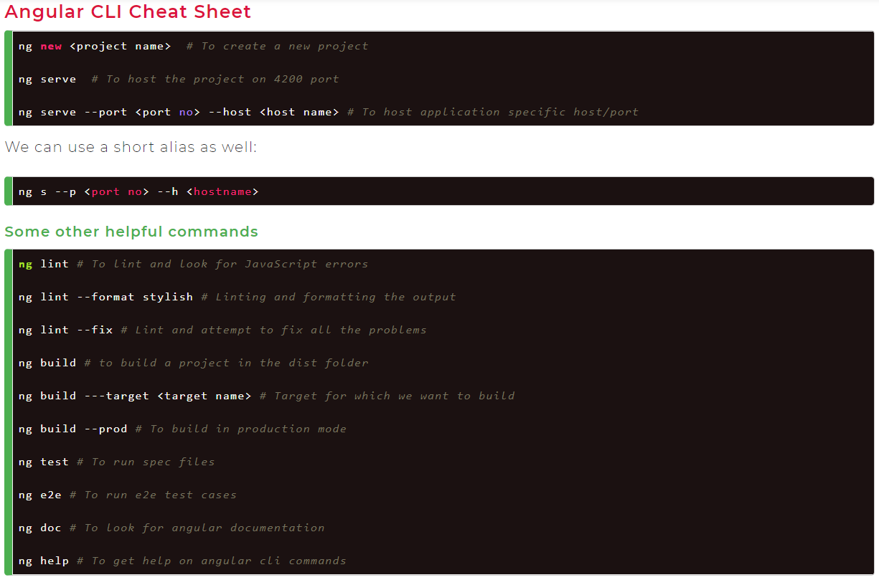
Angular CLI Commands

Slide 13
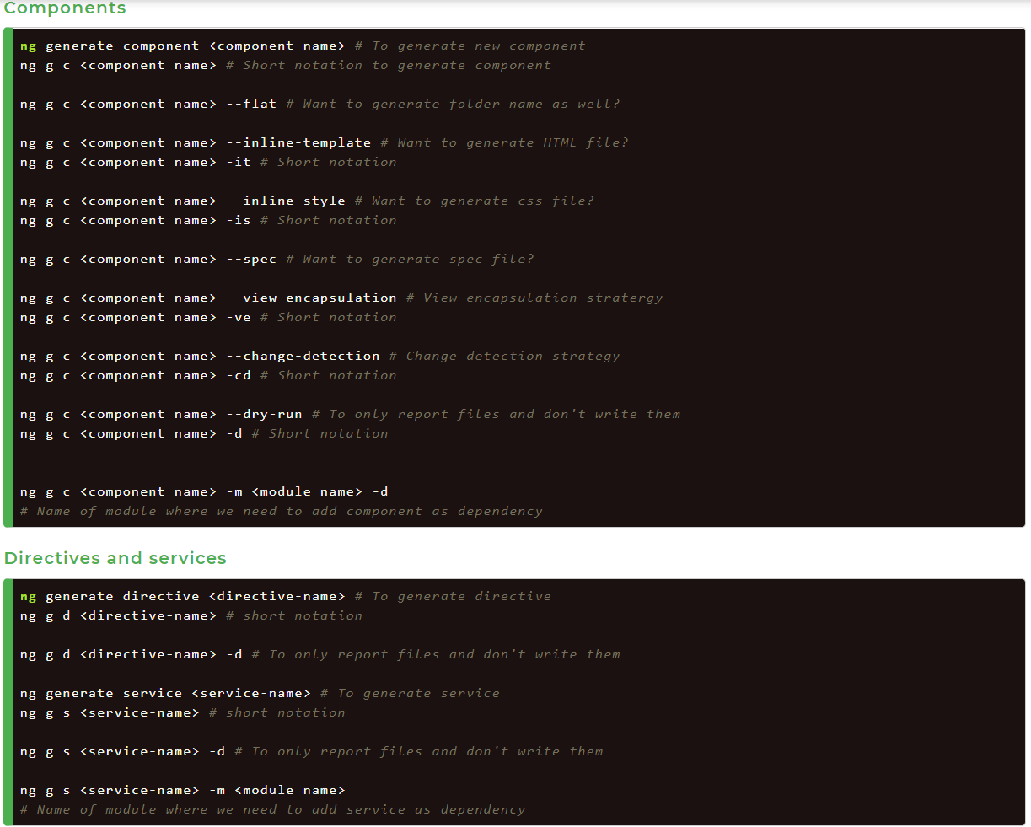
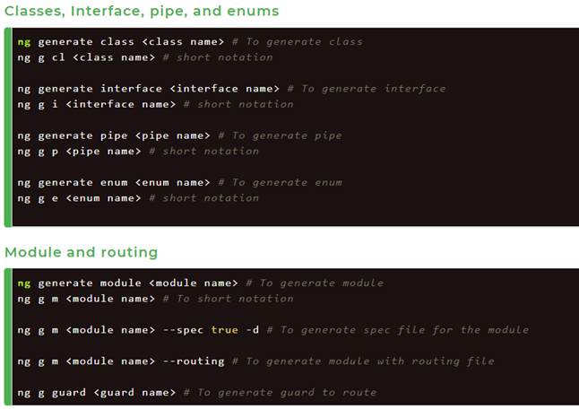
Angular CLI Commands

Slide 14
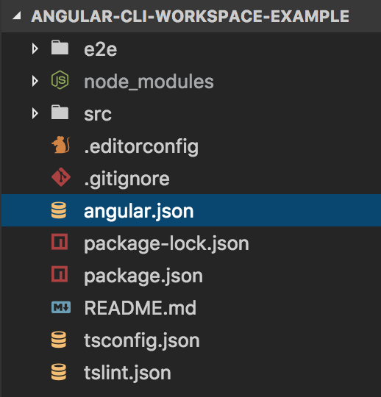
Angular Project - Files & Folder Structure
Project Root
package.json & package-lock.json
Index.html
tsconfig.app.json
src/environments
environments.ts
Environments.prod.ts
src/app
app.module.ts
app.component.ts
app.component.spec.ts
angular.json
tsLint.json
tsConfig.json

Slide 15
Angular Modules
Angular applications are modular.
Modules help organize an application into cohesive functionality blocks by wrapping
components, pipes, directives, services, etc
@NgModule decorator
declarations -> classes belong to this modules
exports -> classes accessible to other modules
imports ->modules whose exported classes are used by the components of this modules
providers->services that are going to be used in other modules
bootstrap->root component, normally AppComponent. Only root modules has this property.
Customization:
npm install
@ng-bootstrap/ng-bootstrap
bootstrap
font-awesome
moment
underscore.js
demo-data.json
Need for Shared Module

Slide 16
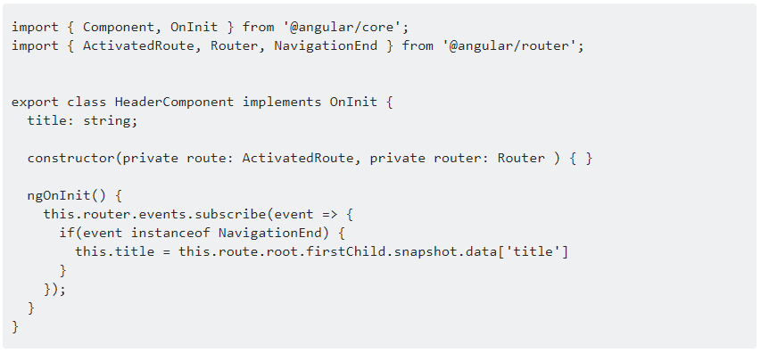
Angular Routing
<base href="/">
import { RouterModule, Routes } from '@angular/router';
The appRoutes are the array of Routes describe how to navigate.
RouterModule.forRoot(routes) & RouterModule.forChild(routes)
<router-outlet></router-outlet>
<a routerLink="/heroes" routerLinkActive="active">Heroes</a>
ActivatedRoute & RouterEvents
Route Guards
CanActivate
CanActivateChild
CanDeactivate
Resolve
CanLoad
https://angular.io/guide/router

Slide 17
Angular Databinding & Pipes
1. String Interpolation
<h1>{{ fullName }} </h1>
2. Property Binding
<h1 [innerHtml]='fullName'></h1>
3. Event Binding
<button (click)=“changeBtnText()”>{{btnText}}</button>
4. Two-Way Data Binding
<input type = "text" [(ngModel)]="userName"/>
5. *ngFor & *ngIf
<button disabled='{{isDisabled}}'>Disable Me</button>
vs
<button [disabled]='isDisabled'>Disable me</button>
Pipes:
Angular 7 provides some built-in pipes:
Lowercasepipe
Uppercasepipe
Datepipe
Currencypipe
Jsonpipe
Percentpipe
Decimalpipe
Slicepipe
Template expression operators:
Pipe
{{title | uppercase}}
safe navigation operator
{{item?.name}}
non-null assertion operator
{{item!.name}}

Slide 18
Angular Directives
Structural Directives
* is Microsyntax only for structural directives
Can’t have more than one structural directive in a tag.
*ngIf
<div *ngIf="hero" class="name">{{hero.name}}</div>
<div *ngIf="condition; then thenBlock else elseBlock"></div>
<ng-template #thenBlock>Then Content</ng-template>
<ng-template # elseBlock >Else Content</ng-template>
*ngFor – index, trackBy
<ul>
<li *ngFor="let hero of heroes; ">{{hero.name}}</li>
</ul>
*ngSwitch
Attribute Directives
ngClass
[ngClass]="{‘<class-name1>’: ’truthy
expression’}“
[class.<class-name>]='truthy expression'
ngStyle
[ngStyle]=“{‘<prop>’: ‘<value>’}”
[style.<property>.<unit>]=“<value>”
[style.color]="getColor()“
[style.font-size.px]="24“ (.px/ .em/ .%)
[ngStyle]="{'font-size’:24, ‘font-weight’: ‘bold’}“
ngNonBindle
<pre ngNonBindable>{{ name }}</pre>
<div [ngSwitch]="hero?.emotion">
<app-happy-hero *ngSwitchCase="'happy'" [hero]="hero"></app-happy-hero>
<app-sad-hero *ngSwitchCase="'sad'" [hero]="hero"></app-sad-hero>
<app-confused-hero *ngSwitchCase="'confused'" [hero]="hero">
</app-confused-hero> <app-unknown-hero *ngSwitchDefault [hero]="hero"></app-unknown-hero>
</div>
https://www.javatpoint.com/angular-7-pipes

Slide 19
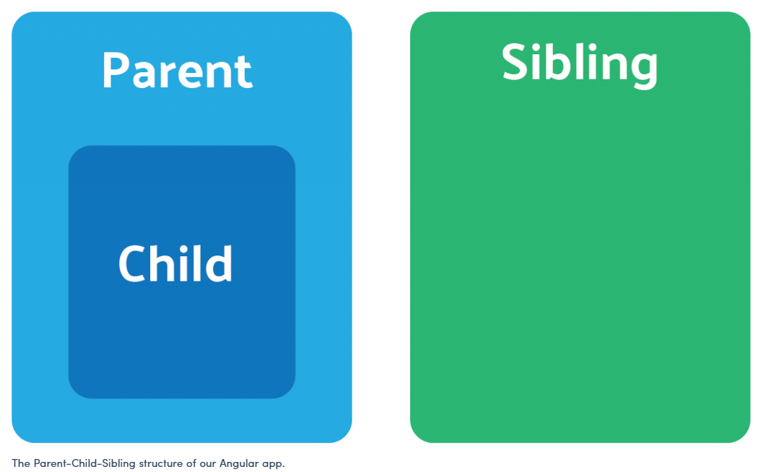
Data Passing between Components
Parent
Input
Child
Child
Output/ Event Emitter
Parent
Child
View
Child
Parent
Comp1
RxJs Services
Comp2

Slide 20
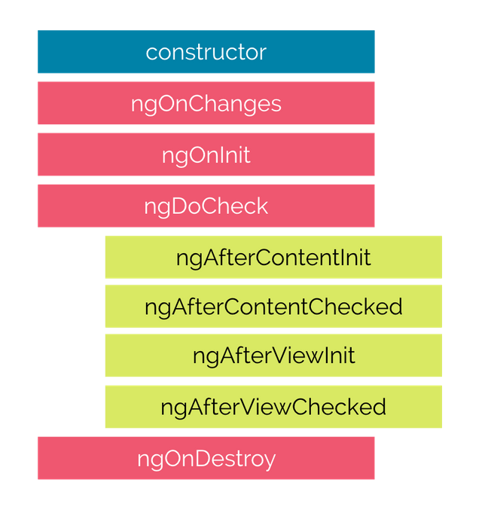
Angular Lifecycle Hooks
ngOnChanges: Called every time a data-bound input property changes. It’s called a first time before the ngOnInit hook. The hook receives a SimpleChanges object that contains the previous and current values for the data-bound inputs properties. This hook gets called often, so it’s a good idea to limit the amount of processing it does.
ngOnInit: Called once upon initialization of the component.
ngDoCheck: Use this hook instead of ngOnChanges for changes that Angular doesn’t detect. It gets called at every change detection cycle, so keeping what it does to a minimum is important for performance.
ngAfterContentInit: Called after content is projected in the component.
ngAfterContentChecked: Called after the projected content is checked.
ngAfterViewInit: Called after a component’s view or child view is initialized.
ngAfterViewChecked: Called after a component’s view or child view is checked.
ngOnDestroy: Called once when the component is destroyed and a good hook to use to cleanup and unsubscribe from observables.

Slide 21
Angular Forms
Template Driven
import {Fo rmsModule} from '@angular/forms';
<form #formData="ngForm"> ... </form>
ngModel & ngModelGroup
Reactive/ Model Driven
import {ReactiveFormsModule} from '@angular/forms';
FormControl, FormGroup & FormBuilder

